Slide 1
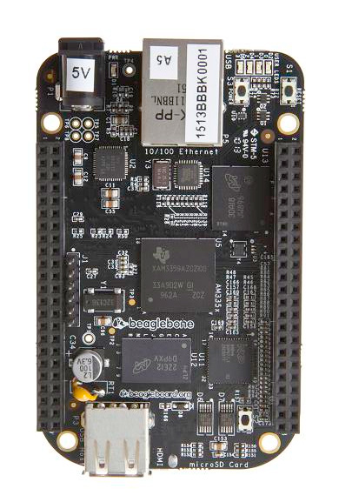
BEAGLEbONE BLACK
By: Sean Tay Jia Yi

Slide 2
Introduction
The BeagleBone Black is embedded Linux development hardware where developers or hobbyist can create softwares or programmes on.
It contains a SDRAM of 512MB running at 800MHZ.
It also has a built in flash of 8 bit and a memory storage of 4GB.
The MicroSD card is preloaded with a customized version of the Angstrom distribution of Linux. Updates of the Angstrom distribution are available at beagleboard.org.
A driver is required in order to communication with the beagle.

Slide 3
Development languages
One of the advantage of the BeagleBone Black is that users are able to use almost every development languages (C, C++, Python, Java)
The Angstrom distribution includes a built-in web-based development environment for Node.js called Cloud9.
User can also download Putty where commands can be send over the net.

Slide 4
Booting via USB CONNECTION
In order to start the BeagleBone Black, we have to connect the SD card and an USB cable to a computer in order to start it. (USB connection powers the Beagle)
To interact with it, the computer needs to have a driver for network-over-USB access to the Beagle (where the drive can be downloaded from https://beagleboard.org/getting-started) This allows the Beagle to act as a Mass Storage Device.
Next access the beagle through Chrome: http://192.168.7.2/ where users can program simple code to test if the board is functioning properly.

Slide 5
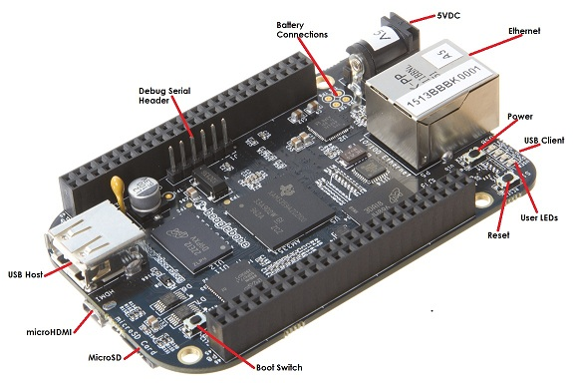
Other methods of BOoting
Via Ethernet cable: Users are also able to access the Beagle through the Ethernet cable but it requires a power cable of 5V.
Via microHDMI: Connect a HDMI to an adapter. The adapter will be used to connect to the microHDMI port

Slide 6
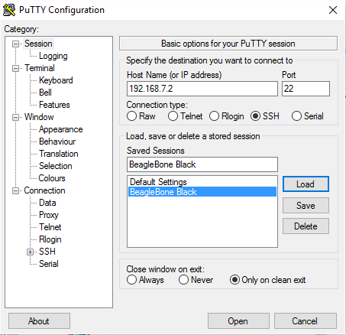
Using putty
PuTTy is a SSH and telnet client.
It allows remote access into the BeagleBone Black and from there we can send commands to perform functions on it.

Slide 7
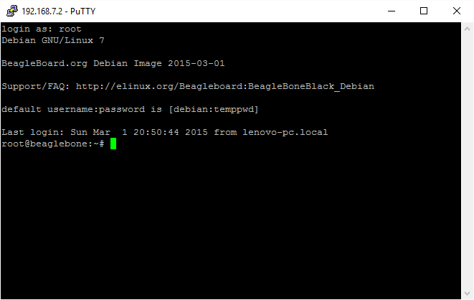
USING putty
Once entered, login in as ‘root’. This will allow user to send commands, edit and create directories or files into the BeagleBone Black.

Slide 8
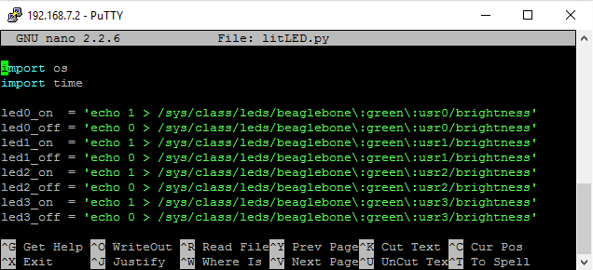
blINKING the ledS

